Slide 1






Foundations of
Quantum Information Science (QIS 102)
Dave Biersach
Brookhaven National Laboratory
dbiersach@bnl.gov
Session 14
Linear Algebra

Slide 2
Session 14 – Goals
Review real and complex vectors, including addition, scalar multiplication, and dot product
Review real and complex matrices, including matrix inversion, transpose, adjoint, and inner product
Identify and use diagonal, symmetric, Identity, Hermitian, and Unitary matrices
Understand basis sets, transition matrices, and the Hadamard matrix
Appreciate the eigenvectors and eigenvalues of a matrix

Slide 3
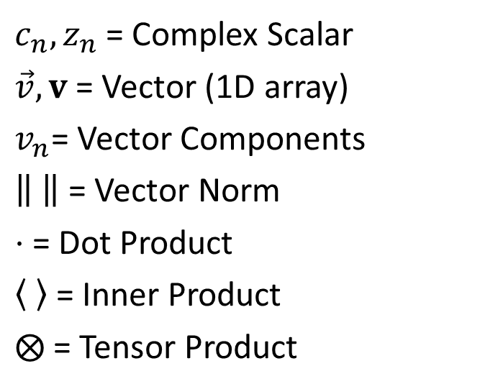
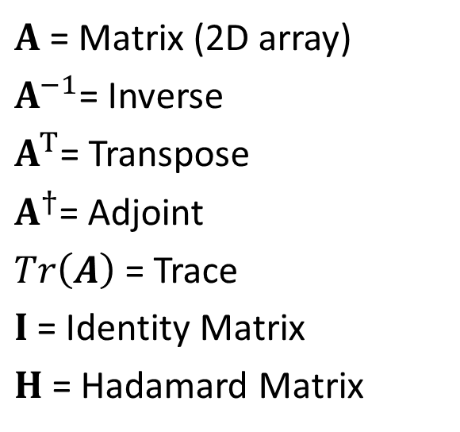
Symbols and Operators
$c_{n},z_{n}$ = Complex Scalar
$\vec{v}, v$ = Vector (1D array)
$v_{n}$= Vector Components
= Vector Norm
$⋅$ = Dot Product
= Inner Product
$⨂$ = Tensor Product
$A$ = Matrix (2D array)
$A^{−1}$= Inverse
$A^{T}$= Transpose
$A^{†}$= Adjoint
$Tr\left(A\right)$ = Trace
$I$ = Identity Matrix
$H$ = Hadamard Matrix

Slide 4
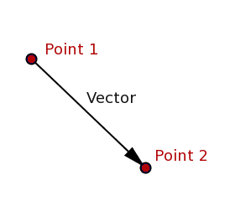
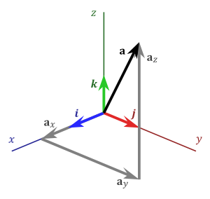
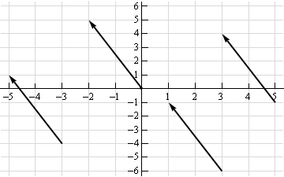
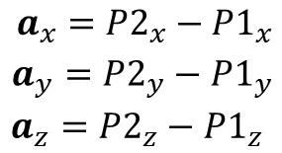
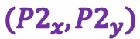
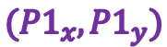
Real Vectors
$a_{x} a_{y} a_{z}$ are the components of
vector$\overset{⃑}{a}$
$$({P2}_{x},{P2}_{y})$$
A Magnitude & Direction
These four vectors are all the same!
$$({P1}_{x},{P1}_{y})$$

Slide 5
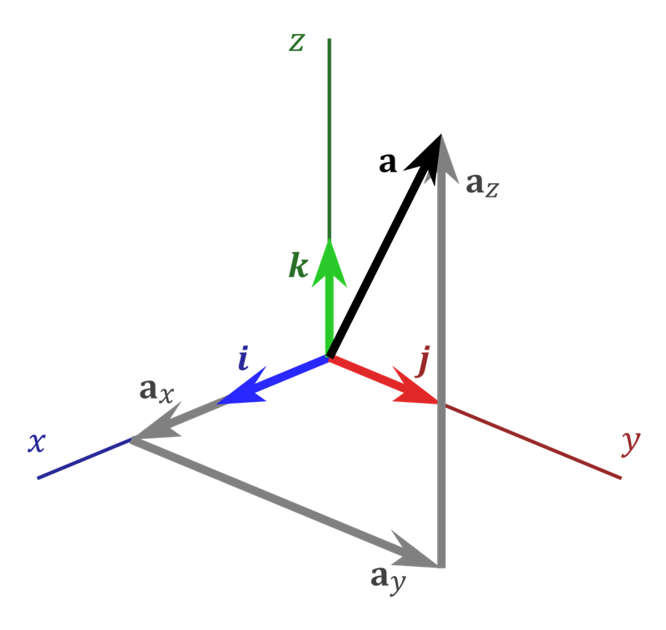

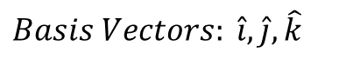
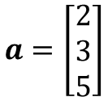

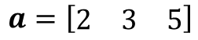
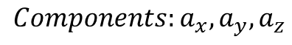
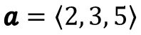
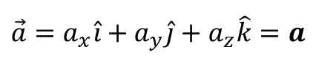
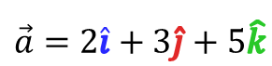
Real Vectors
$$Basis Vectors: \hat{i},\hat{j},\hat{k}$$
A vector is any “directed”
line segment
$$(2, 3, 5)$$
The hat indicates a Unit Vector
(length is 1)
$$Components:a_{x},a_{y},a_{z}$$
How much of each basis makes up $\vec{a}$
Boldface
$$\vec{a}=a_{x}\hat{i}+a_{y}\hat{j}+a_{z}\hat{k}=a$$
Vectors are basis independent,
but the components are not
$$\vec{a}=2\hat{i}+3\hat{j}+5\hat{k}$$
$$a=\left[\begin{matrix}2 \\ 3 \\ 5\end{matrix}\right]$$
A “column”
vector
$$a=\left[\begin{matrix}2 & 3 & 5\end{matrix}\right]$$
$$a=\left\langle 2, 3, 5\right\rangle$$
A “row” vector

Slide 6
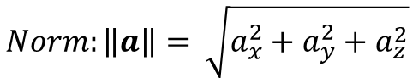
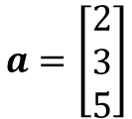
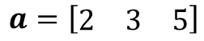

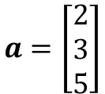
Real Vectors
$$a=\left[\begin{matrix}2 & 3 & 5\end{matrix}\right]$$
A vector is a “directed”
line segment
$$(2, 3, 5)$$
May seem like 1 row x 3 columns
$$a=\left[\begin{matrix}2 \\ 3 \\ 5\end{matrix}\right]$$
May seem like 3 rows x 1 column
But… a vector is strictly a one-dimensional (1D) object
$$Norm:\left\|a\right\|= \sqrt{a_{x}^{2}+a_{y}^{2}+a_{z}^{2}}$$
$$\vec{a}=2\hat{i}+3\hat{j}+5\hat{k}$$
$$a=\left[\begin{matrix}2 \\ 3 \\ 5\end{matrix}\right]$$
A “column”
vector
In basis $\hat{i},\hat{j},\hat{k}$
$$a=\left\langle 2, 3, 5\right\rangle$$

Slide 7
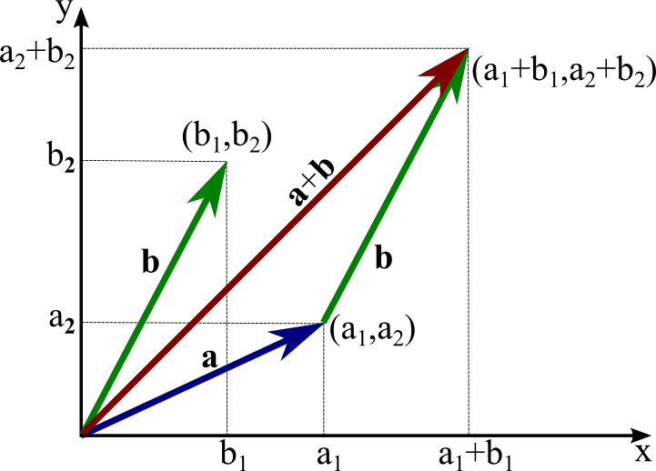
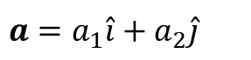
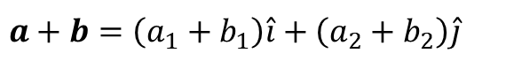
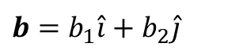
Real Vectors – Addition (Vector + Vector)
$$a=a_{1}\hat{i}+a_{2}\hat{j}$$
$$b=b_{1}\hat{i}+b_{2}\hat{j}$$
$$a+b=\left(a_{1}+b_{1}\right)\hat{i}+\left(a_{2}+b_{2}\right)\hat{j}$$

Slide 8
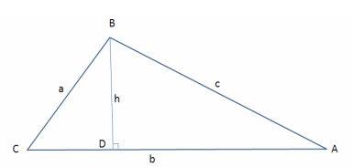


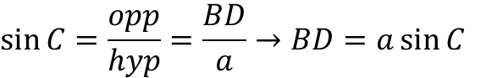
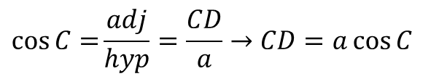

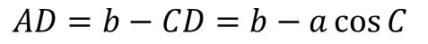
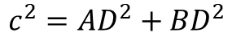

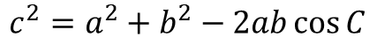
Real Vectors – Dot Product (Vector $⋅$Vector)
In $Δ BCD$:
$$\cos{C=}\frac{adj}{hyp}=\frac{CD}{a}→CD=a\cos{C}$$
$$\sin{C}=\frac{opp}{hyp}=\frac{BD}{a}→BD=a\sin{C}$$
In $Δ ABC$:
$$AD=b−CD=b−a\cos{C}$$
In $Δ ABD$:
Law of Cosines
$$c^{2}={AD}^{2}+{BD}^{2}$$
The square of a side of a triangle equals the sum of the squares of the remaining sides minus twice the product of those sides and the cosine of the angle between them
$$c^{2}={\left(b−a\cos{C}\right)}^{2}+{\left(a\sin{C}\right)}^{2}$$
1
$$c^{2}=a^{2}\left(\sin^{2}{C}+\cos^{2}{C}\right)+b^{2}−2ab\cos{C}$$
$$c^{2}=a^{2}+b^{2}−2ab\cos{C}$$

Slide 9
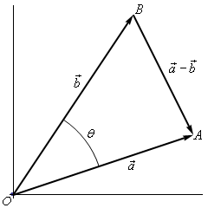
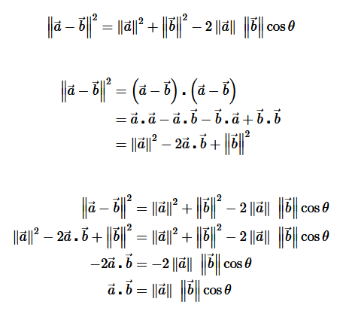
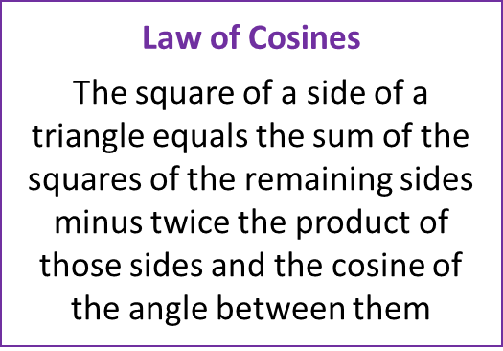
Real Vectors – Dot Product (Vector $⋅$Vector)

Slide 10
Real Vectors – Dot Product (Vector $⋅$Vector)

Slide 11
Real Vectors – Dot Product (Vector $⋅$Vector)

Slide 12
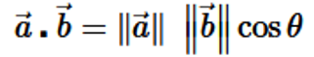
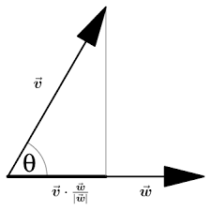
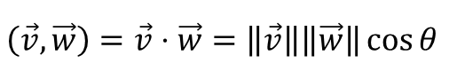

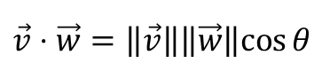

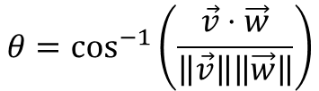
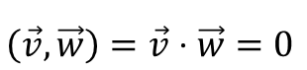
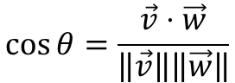
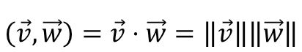
Real Vectors – Dot Product (Vector $⋅$Vector)
$$\vec{v}⋅\vec{w}=\left\|\vec{v}\right\|\left\|\vec{w}\right\|cos{θ}$$
$$\cos{θ}=\frac{\vec{v}⋅\vec{w}}{\left\|\vec{v}\right\|\left\|\vec{w}\right\|}$$
$$θ=\cos^{−1}\left(\frac{\vec{v}⋅\vec{w}}{\left\|\vec{v}\right\|\left\|\vec{w}\right\|}\right)$$
$$\left(\vec{v},\vec{w}\right)=\vec{v}⋅\vec{w}=\left\|\vec{v}\right\|\left\|\vec{w}\right\|\cos{θ}$$
← Dot product (Euclidean)
$$\left(\vec{v},\vec{w}\right)=\vec{v}⋅\vec{w}=\left\|\vec{v}\right\|\left\|\vec{w}\right\|$$
← If parallel $\left(θ=0\right)$
$$\left(\vec{v},\vec{w}\right)=\vec{v}⋅\vec{w}=0$$
← If perpendicular $\left(θ=\frac{π}{2}\right)$

Slide 13

Real Vectors – Dot Product (Vector $⋅$Vector)
But how do you calculate the dot product?
Implicit Summation
For generalized
real vectors
(not necessarily Euclidean 2D)
$$\left(v,w\right)=v⋅w=v_{1}w_{1}+v_{2}w_{2}{+v}_{n}w_{n}$$
← Inner product (produces a scalar)
$$\left(v,v\right)=v⋅v=v_{1}v_{1}+v_{2}v_{2}{+v}_{n}v_{n}={\left\|v\right\|}^{2}$$
$$\left\|v\right\|=\sqrt{v⋅v}$$
The norm of a real vector is the square root of its own inner product

Slide 14

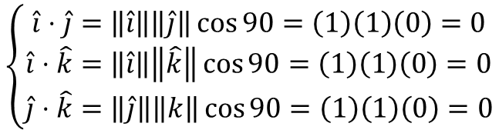
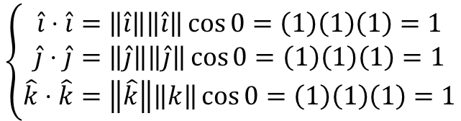
Real Vectors – Dot Product (Vector $⋅$Vector)
Each of these unit vectors lies entirely along itself
$$\left\{\begin{matrix}\hat{i}⋅\hat{i}=\left\|\hat{i}\right\|\left\|\hat{i}\right\|\cos{0}=\left(1\right)\left(1\right)\left(1\right)=1 \\ \hat{j}⋅\hat{j}=\left\|\hat{j}\right\|\left\|\hat{j}\right\|\cos{0}=\left(1\right)\left(1\right)\left(1\right)=1 \\ \hat{k}⋅\hat{k}=\left\|\hat{k}\right\|\left\|k\right\|\cos{0}=\left(1\right)\left(1\right)\left(1\right)=1\end{matrix}\right.$$
$$\left\{\begin{matrix}\hat{i}⋅\hat{j}=\left\|\hat{i}\right\|\left\|\hat{j}\right\|\cos{90}=\left(1\right)\left(1\right)\left(0\right)=0 \\ \hat{i}⋅\hat{k}=\left\|\hat{i}\right\|\left\|\hat{k}\right\|\cos{90}=\left(1\right)\left(1\right)\left(0\right)=0 \\ \hat{j}⋅\hat{k}=\left\|\hat{j}\right\|\left\|k\right\|\cos{90}=\left(1\right)\left(1\right)\left(0\right)=0\end{matrix}\right.$$
No part of these unit vectors lies along any other
$\hat{i},\hat{j},\hat{k}$ are the canonical orthonormal basis vectors in $ℝ^{3}$

Slide 15
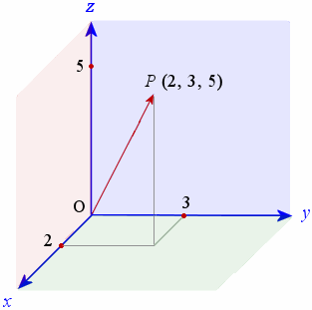


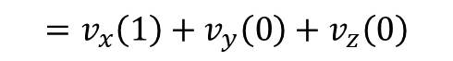
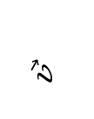
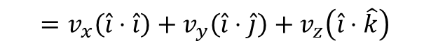

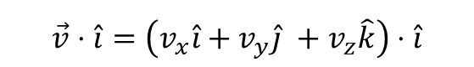


Real Vectors – Dot Product (Vector $⋅$Vector)
$$\vec{v}⋅\hat{i}=\left(v_{x}\hat{i}+v_{y}\hat{j} +v_{z}\hat{k}\right)⋅\hat{i}$$
$v_{n}$= Vector Components
aka "scalars"
$$\vec{v}$$
$$=v_{x}\left(\hat{i}⋅\hat{i}\right)+v_{y}\left(\hat{i}⋅\hat{j}\right)+v_{z}\left(\hat{i}⋅\hat{k}\right)$$
$$=v_{x}\left(1\right)+v_{y}\left(0\right)+v_{z}\left(0\right)$$
$$=v_{x}$$
$$\vec{v}⋅\hat{i}=v_{x}$$
We can get the individual components of a real vector by forming the dot product with each of its orthonormal basis vectors
$$\vec{v}⋅\hat{j}=v_{y}$$
$$\vec{v}⋅\hat{k}=v_{z}$$

Slide 16
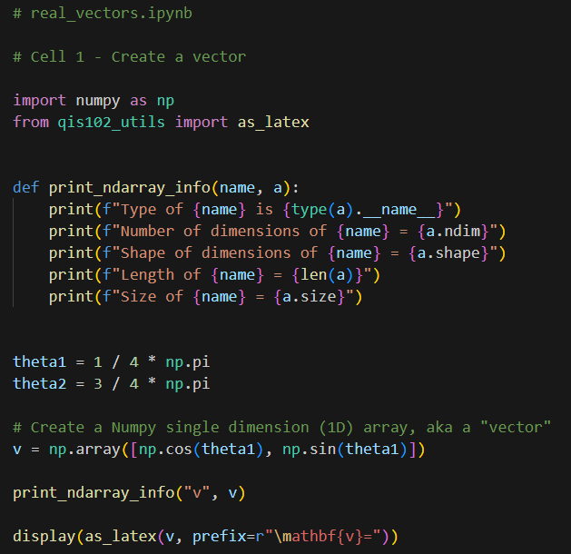
Open Cell 1 – real_vectors.ipynb
①
②
③
You can create a Numpy ndarray
from a Python list using np.array()
④
⑤
⑥
⑦

Slide 17
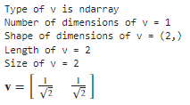





Run Cell 1 – real_vectors.ipynb
len() only returns the number of items in the
1st dimension of an np.ndarray
$$\vec{v}$$
$$θ_{1}$$
$$\frac{1}{4}π$$
$v$ is a vector with two elements, but is still just a 1-D object
$$\left(1,0\right)$$
Notice the comma with nothing after it

Slide 18




Run Cells 2 & 3 – real_vectors.ipynb
$$\vec{w}$$
$$\vec{v}$$
$$\frac{3}{4}π$$
$$θ_{2}$$
$$θ_{1}$$
$$\frac{1}{4}π$$
$$\left(1,0\right)$$
①

Slide 19










Run Cell 4 – real_vectors.ipynb
①
②
③
④
$$\vec{w}$$
$$\vec{v}$$
$$\frac{3}{4}π$$
$$θ_{2}$$
$$θ_{1}$$
$$\frac{1}{4}π$$
$$\left(1,0\right)$$
$$θ=\cos^{−1}\left(\frac{v⋅w}{\left\|v\right\|\left\|w\right\|}\right)$$

Slide 20


Run Cell 5 – real_vectors.ipynb
①
②
LaTeX Math Symbols - Handy Reference

Slide 21



Run Cell 6 – real_vectors.ipynb
①
①

Slide 22
Symbols and Operators
$c_{n},z_{n}$ = Complex Scalar
$\vec{v}, v$ = Vector (1D array)
$v_{n}$= Vector Components
= Vector Norm
$⋅$ = Dot Product
= Inner Product
$⨂$ = Tensor Product
$A$ = Matrix (2D array)
$A^{−1}$= Inverse
$A^{T}$= Transpose
$A^{†}$= Adjoint
$Tr\left(A\right)$ = Trace
$I$ = Identity Matrix
$H$ = Hadamard Matrix

Slide 23
Matrices
A “matrix” in NumPy is represented as vectors of vectors
A matrix can hold any number of elements (in each dimension), but all elements must be of the same data type, such as int or float
Matrix elements are accessed by their index numbers, which starts at zero and correspond to each dimension
Matrix nomenclature
In mathematics, a matrix size is written as (Rows x Columns)
In NumPy a matrix (aka a ndarray) is written using commas instead of multiplication crosses, and using square brackets instead of parenthesis: [Row, Column]
Example: the NumPy array [5,7] has 5 rows and 7 columns

Slide 24

Open Cell 1 – matrix_algebra.ipynb
①
②
③
④

Slide 25



Run Cell 1 – matrix_algebra.ipynb
①
len() only returns the number of items in the
1st dimension of an np.ndarray
②
③
Matrix names are written in boldface and Capitalized
2 rows by 3 cols
$$2×3$$
④
⑤
⑥
Matrices can differ in shape but agree in size
We are creating 2-D arrays
3 rows by 2 cols
$$3×2$$
Length is the number of rows
size is the total number of components

Slide 26

Matrix Multiplication
When rendering computer graphics, we often need to find the product of two matrices, e.g.
$$\left(\begin{matrix}4 & 5 & 8 \\ 1 & 9 & 7\end{matrix}\right)⋅\left(\begin{matrix}2 & 4 \\ 6 & 1 \\ 5 & 9\end{matrix}\right)= ?$$
There is a standard algorithm to do this multiplication
It involves multiplying each element in the rows of first matrix by each element in the columns of the second matrix, with an implicit summation of those products

Slide 27
Matrix Multiplication
In order to multiply two matrices together, the number of columns in matrix A must equal the number of rows in matrix B (Cols A = Rows B)
The resulting matrix will have as many rows as there were rows in matrix A, and as many columns as there were columns in matrix B (Rows A x Cols B)

Slide 28


Matrix Multiplication
Example
Matrix A has dimension (2 x 3) = 2 rows, 3 columns
Matrix B has dimension (3 x 2) = 3 rows, 2 columns
$$\left(\begin{matrix}4 & 5 & 8 \\ 1 & 9 & 7\end{matrix}\right)⋅\left(\begin{matrix}2 & 4 \\ 6 & 1 \\ 5 & 9\end{matrix}\right)= ?$$
The inner values must match!
A
B
(2 x 3) $⋅$ (3 x 2)
A
B
The outer values will be
the dimension of the final
matrix product!

Slide 29

Matrix Multiplication
Matrix multiplication is not commutative!
If we multiple A x B we may get a different matrix than if we multiply B x A
(3 x 2) $⋅$ (2 x 3) = result is a (3 x 3) matrix
(2 x 3) $⋅$ (3 x 2) = result is a (2 x 2) matrix
You might not even be able to multiply in the reverse order
(2 x 3) $⋅$ (3 x 5) = result is a (2 x 5) matrix
(3 x 5) $⋅$ (2 x 3) = Not allowed (5 $≠$ 2)aaa
Welcome to the world of non-commutative algebra
This is very strange – it catches even great physicists by surprise!
This asymmetry is the foundation of the matrix formulation of quantum mechanics

Slide 30

Matrix Multiplication
The algorithm is simple but tedious for A $∙$ B = C
Sum the product of every element in each row of matrix A and the corresponding element in each column of matrix B
That sum becomes just one element in new matrix C
Continue this process for all rows in matrix A
Every row in A gets multiplied by every column in B
The resulting matrix will have dimensions (Rows A x Cols B)

Slide 31

Matrix Multiplication

Slide 32
Matrix Multiplication

Slide 33
Matrix Multiplication

Slide 34
Matrix Multiplication

Slide 35
Matrix Multiplication

Slide 36


Run Cells 2 & 3 – matrix_algebra.ipynb
①
②
See slide #34
③
$$3×2∙2×3=3×3$$

Slide 37



Run Cell 4 – matrix_algebra.ipynb
Operand 0 (b)
Operand 1 (a)
$$3×2∙3×3=Error!$$
Dimension 0
Generalized Universal Function API

Slide 38


Matrix Nomenclature
Identity Matrix

Slide 39
















Matrix Inversion
Non-square matrices are not directly invertible
Matrix “Division”
Solve System of Linear Equations
$$\frac{A}{B}=A⋅B^{−1}$$
$$A⋅x=B$$
$$A^{−1}⋅\left(A⋅x\right)=A^{−1}⋅B$$
$$A$$
$$x$$
$$B$$
$$4r+7s=47$$
$$\left[\begin{matrix}4 & 7 \\ 3 & −5\end{matrix}\right]\left[\begin{matrix}r \\ s\end{matrix}\right]=\left[\begin{matrix}47 \\ −16\end{matrix}\right]$$
$$\left(A^{−1}⋅A\right)⋅x=A^{−1}⋅B$$
$$3r−5s=−16$$
$$I⋅x=A^{−1}⋅B$$
$$x=A^{−1}⋅B$$
$$4(3)+7(5)=47$$
$$\left[\begin{matrix}4 & 7 \\ 3 & −5\end{matrix}\right]\left[\begin{matrix}3 \\ 5\end{matrix}\right]=\left[\begin{matrix}47 \\ −16\end{matrix}\right]$$
$$3(3)−5(5)=−16$$

Slide 40
Determinant of a Matrix
In linear algebra, the determinant is a value that can be computed from the elements of a square matrix
The determinant can be used:
To solve a system of linear equations when those equations are represented by a matrix
To find the Jacobian of the matrix of all first-order partial derivatives of a vector-valued function
To calculate the characteristic polynomial of a matrix which is essential for eigenvalue problems
To express the signed n-dimensional volumes of n-dimensional parallelepipeds in analytic geometry

Slide 41
Determinant of a Matrix
Calculating the Determinant of a 2 x 2 Matrix
$$A=\left[\begin{matrix}a_{11} & a_{12} \\ a_{21} & a_{22}\end{matrix}\right]→\det{A}=\left|A\right|=\left|\begin{matrix}a_{11} & a_{12} \\ a_{21} & a_{22}\end{matrix}\right|$$
$$det\left[\begin{matrix}a_{11} & a_{12} \\ a_{21} & a_{22}\end{matrix}\right]=a_{11}∙a_{22}−a_{12}∙a_{21}$$
$$det\left[\begin{matrix}a_{11} & a_{12} \\ a_{21} & a_{22}\end{matrix}\right]=a_{11}∙a_{22}−a_{12}∙a_{21}$$

Slide 42
Determinant of a Matrix
Calculating the Determinant of a 2 x 2 Matrix
$$A=\left[\begin{matrix}a_{11} & a_{12} \\ a_{21} & a_{22}\end{matrix}\right]→\det{A}=\left|A\right|=\left|\begin{matrix}a_{11} & a_{12} \\ a_{21} & a_{22}\end{matrix}\right|$$
$$det\left[\begin{matrix}a_{11} & a_{12} \\ a_{21} & a_{22}\end{matrix}\right]=a_{11}∙a_{22}−a_{12}∙a_{21}$$
$$det\left[\begin{matrix}8 & 3 \\ 4 & 2\end{matrix}\right]=8∙2 −3∙4=16−12=4$$

Slide 43
Determinant of a Matrix
Calculating the Determinant of a 3 x 3 Matrix
$$\det{A}=\left|A\right|=\left|\begin{matrix}a_{11} & a_{12} & a_{13} \\ a_{21} & a_{22} & a_{23} \\ a_{31} & a_{32} & a_{33}\end{matrix}\right|$$
$$\left|A\right|=a_{11}\left|\begin{matrix}a_{22} & a_{23} \\ a_{32} & a_{33}\end{matrix}\right|−a_{21}\left|\begin{matrix}a_{12} & a_{13} \\ a_{32} & a_{33}\end{matrix}\right|+a_{31}\left|\begin{matrix}a_{12} & a_{13} \\ a_{22} & a_{23}\end{matrix}\right|$$

Slide 44
Determinant of a Matrix
Calculating the Determinant of a 3 x 3 Matrix
$$\det{A}=\left|A\right|=\left|\begin{matrix}a_{11} & a_{12} & a_{13} \\ a_{21} & a_{22} & a_{23} \\ a_{31} & a_{32} & a_{33}\end{matrix}\right|$$
$$\left|A\right|=a_{11}\left|\begin{matrix}a_{22} & a_{23} \\ a_{32} & a_{33}\end{matrix}\right|−a_{21}\left|\begin{matrix}a_{12} & a_{13} \\ a_{32} & a_{33}\end{matrix}\right|+a_{31}\left|\begin{matrix}a_{12} & a_{13} \\ a_{22} & a_{23}\end{matrix}\right|$$

Slide 45
Determinant of a Matrix
Calculating the Determinant of a 3 x 3 Matrix
$$\det{A}=\left|A\right|=\left|\begin{matrix}a_{11} & a_{12} & a_{13} \\ a_{21} & a_{22} & a_{23} \\ a_{31} & a_{32} & a_{33}\end{matrix}\right|$$
$$\left|A\right|=a_{11}\left|\begin{matrix}a_{22} & a_{23} \\ a_{32} & a_{33}\end{matrix}\right|−a_{21}\left|\begin{matrix}a_{12} & a_{13} \\ a_{32} & a_{33}\end{matrix}\right|+a_{31}\left|\begin{matrix}a_{12} & a_{13} \\ a_{22} & a_{23}\end{matrix}\right|$$

Slide 46
Determinant of a Matrix
Calculating the Determinant of a 3 x 3 Matrix
$$\det{A}=\left|A\right|=\left|\begin{matrix}a_{11} & a_{12} & a_{13} \\ a_{21} & a_{22} & a_{23} \\ a_{31} & a_{32} & a_{33}\end{matrix}\right|$$
$$\left|A\right|=a_{11}\left|\begin{matrix}a_{22} & a_{23} \\ a_{32} & a_{33}\end{matrix}\right|−a_{21}\left|\begin{matrix}a_{12} & a_{13} \\ a_{32} & a_{33}\end{matrix}\right|+a_{31}\left|\begin{matrix}a_{12} & a_{13} \\ a_{22} & a_{23}\end{matrix}\right|$$

Slide 47

Determinant of a Matrix
Calculating the Determinant of a 4 x 4 Matrix
Notice the definition of determinant is inherently recursive:
The determinant of a $n x n$matrix is calculated from the determinants of $n$ reduced matrices of size $(n−1)×(n−1)$,
and so on and so on, getting down to simple 2 x 2 matrices

Slide 48
Determinant of a Matrix
Calculating the Determinant of a 4 x 4 Matrix
These smaller matrices, where a row and column has been removed, are called the cofactors of the original (larger) matrix
Notice the sign in front of each cofactor alternates from positive (+1) to negative (-1)

Slide 49


Run Cell 5 – matrix_algebra.ipynb
①
②
③
⑤
⑦
④
⑥
⑧

Slide 50


Run Cell 6 – matrix_algebra.ipynb
①
Determinants can get quite large!
②

Slide 51

Determinant of a Matrix
Always seek independent confirmation!

Slide 52






Goal: Solve a System of Linear Equations
Two Equations and Two Unknowns
$$4x+7y=47$$
$$ax+by=c$$
$$a=4, b=7, c=47$$
$$3x−5y=−16$$
$$dx+ey=f$$
$$d=3,e=−5,f=−16$$
$$ax=c−by$$
$$\frac{d(c−by)}{a}+ey=f$$
$$x=\frac{c−by}{a}$$
$$cd−bdy+aey=af$$
$$y\left(ae−bd\right)=af−cd$$
$$y=\frac{\left(4\right)\left(−16\right)−(47)(3)}{\left(4\right)\left(−5\right)−(7)(3)}=\frac{−205}{−41}=5$$
$$y=\frac{af−cd}{ae−bd}$$

Slide 53

Goal: Solve a System of Linear Equations
Two Equations and Two Unknowns
$$4x+7y=47$$
$$ax+by=c$$
$$a=4, b=7, c=47$$
$$3x−5y=−16$$
$$dx+ey=f$$
$$d=3,e=−5,f=−16$$
$$by=c−ax$$
$$dx+\frac{e(c−ax)}{b}=f$$
$$y=\frac{c−ax}{b}$$
$$bdx+ce−aex=bf$$
$$x\left(bd−ae\right)=bf−ce$$
$$x=\frac{\left(47\right)\left(−5\right)−(7)(−16)}{\left(4\right)\left(−5\right)−(7)(3)}=\frac{−123}{−41}=3$$
$$x=\frac{bf−ce}{bd−ae}\left(\frac{−1}{−1}\right)=\frac{ce−bf}{ae−bd}$$

Slide 54



Goal: Solve a System of Linear Equations
Two Equations and Two Unknowns
$$4x+7y=47$$
$$ax+by=c$$
$$a=4, b=7, c=47$$
$$3x−5y=−16$$
$$dx+ey=f$$
$$d=3,e=−5,f=−16$$
$$x=\frac{ce−bf}{ae−bd}$$
$$y=\frac{af−cd}{ae−bd}$$
$$\det{C=\left|\begin{matrix}a & b \\ d & e\end{matrix}\right|=ae−bd}$$
$$\left|C\right|=\left(4\right)\left(−5\right)−\left(7\right)\left(3\right)=−41$$

Slide 55
Goal: Solve a System of Linear Equations
Two Equations and Two Unknowns
$$ax+by=c$$
Overlay the x coefficients with the RHS values
$$dx+ey=f$$
$$\det{A=\left|\begin{matrix}c & b \\ f & e\end{matrix}\right|=ce−bf}$$
$$x=\frac{ce−bf}{ae−bd}$$
$$y=\frac{af−cd}{ae−bd}$$
$$\det{C=\left|\begin{matrix}a & b \\ d & e\end{matrix}\right|=ae−bd}$$
$$\left|A\right|=\left(47\right)\left(−5\right)−\left(7\right)\left(−16\right)=−123$$
$$\left|C\right|=\left(4\right)\left(−5\right)−\left(7\right)\left(3\right)=−41$$

Slide 56
Goal: Solve a System of Linear Equations
Two Equations and Two Unknowns
$$ax+by=c$$
Overlay the y coefficients with the RHS values
$$dx+ey=f$$
$$\det{A=\left|\begin{matrix}c & b \\ f & e\end{matrix}\right|=ce−bf}$$
$$x=\frac{ce−bf}{ae−bd}$$
$$\det{B=\left|\begin{matrix}a & c \\ d & f\end{matrix}\right|=af−cd}$$
$$y=\frac{af−cd}{ae−bd}$$
$$\det{C=\left|\begin{matrix}a & b \\ d & e\end{matrix}\right|=ae−bd}$$
$$\left|A\right|=\left(47\right)\left(−5\right)−\left(7\right)\left(−16\right)=−123$$
$$\left|B\right|=\left(4\right)\left(−16\right)−\left(47\right)\left(3\right)=−205$$
$$\left|C\right|=\left(4\right)\left(−5\right)−\left(7\right)\left(3\right)=−41$$

Slide 57




Goal: Solve a System of Linear Equations
Two Equations and Two Unknowns
$$4(3)+7(5)=47$$
$$ax+by=c$$
$$3(3)−5(5)=−16$$
$$dx+ey=f$$
$$\det{A=\left|\begin{matrix}c & b \\ f & e\end{matrix}\right|=ce−bf}$$
$$x=\frac{ce−bf}{ae−bd}$$
$$x=\frac{\left|A\right|}{\left|C\right|}$$
$$\det{B=\left|\begin{matrix}a & c \\ d & f\end{matrix}\right|=af−cd}$$
$$y=\frac{af−cd}{ae−bd}$$
$$y=\frac{\left|B\right|}{\left|C\right|}$$
$$\det{C=\left|\begin{matrix}a & b \\ d & e\end{matrix}\right|=ae−bd}$$
$$x=\frac{\left|A\right|}{\left|C\right|}=\frac{−123}{−41}=3$$
$$\left|A\right|=\left(47\right)\left(−5\right)−\left(7\right)\left(−16\right)=−123$$
$$\left|B\right|=\left(4\right)\left(−16\right)−\left(47\right)\left(3\right)=−205$$
$$y=\frac{\left|B\right|}{\left|C\right|}=\frac{−205}{−41}=5$$
$$\left|C\right|=\left(4\right)\left(−5\right)−\left(7\right)\left(3\right)=−41$$

Slide 58

Goal: Solve a System of Linear Equations
Three Equations and Three Unknowns

Slide 59

Cramer’s Rule
Second, we create an additional overlay matrix for each unknown
First, we create a matrix from the unknown coefficients

Slide 60

Run Cell 7 – matrix_algebra.ipynb
①
②
③
④

Slide 61



Run Cell 8 – matrix_algebra.ipynb
①
②
③
④
⑤

Slide 62

Run Cell 9 – matrix_algebra.ipynb
①
②

Slide 63




Matrix Transpose (T)
Interchange Rows for Columns
$$\left[\begin{matrix}v_{0} \\ v_{1} \\ v_{2} \\ v_{3}\end{matrix}\right]={\left[v_{0},v_{1}{,v}_{2},v_{3}\right]}^{T}$$
To save print space, authors often write a vector as a row matrix followed by the T operator
A vector can be written as a column matrix…
…or as a row matrix
$$(1, 4)$$
$$(4, 1)$$

Slide 64




Matrix Adjoint (H) and Trace
Aka "Dagger" →
$$A^{†}={\left(\overline{A}\right)}^{T}=\overline{A^{T}}=A^{H}$$
← Hermitian adjoint
$$Tr\left[\begin{matrix}a & b & c \\ d & e & f \\ g & h & i\end{matrix}\right]=a+e+i$$
The "Trace" →
Note: Only square matrices have a trace!

Slide 65





Hermitian Matrix
All Hermitian matrices are square and equal to their own conjugate transpose
$∴$ all diagonal elements $∈ ℝ$
A matrix is Hermitian if
Charles Hermite
(1822-1901)
$$A^{†}=A$$
Note: H may also refer to a Hadamard Matrix

Slide 66







Complex Vector Algebra
$$v+w=\left(v+w\right)$$
Vector Addition
$$\left(−v\right)=−\left(v\right)$$
Additive Inverse
$$c⋅v=\left(c∙v\right)$$
Scalar Multiplication
Scalar doesn't mean only $∈ℝ$

Slide 67









Complex Scalar Multiplication
$$v=v_{1}\hat{i}+v_{2}\hat{j}+v_{3}\hat{k}$$
$$v_{1},v_{2},v_{3}∈ℝ or ℂ$$
$$\left\|v\right\|=\sqrt{{\left|v_{1}\right|}^{2}+{\left|v_{2}\right|}^{2}+{\left|v_{3}\right|}^{2}}$$
Unit basis vectors have length = 1
$$z∈ℂ$$
$$\left|z\right|⋅\left\|v\right\|=\left|z\right|\sqrt{{\left|v_{1}\right|}^{2}+{\left|v_{2}\right|}^{2}+{\left|v_{3}\right|}^{2}}$$
$$\left|z\right|∈ℝ$$
$$\left\|\left|z\right|⋅v\right\|=\sqrt{{\left(\left|z\right|{⋅v}_{1}\hat{i}\right)}^{2}+{\left(\left|z\right|⋅v_{2}\hat{j}\right)}^{2}+{\left(\left|z\right|⋅v_{3}\hat{k}\right)}^{2}}$$
Real Scalar Multiplication respects Norms
$$= \sqrt{{\left|z\right|}^{2}\left({\left|v_{1}\right|}^{2}+{\left|v_{2}\right|}^{2}+{\left|v_{3}\right|}^{2}\right)}$$
$$=\left|z\right|\sqrt{{\left|v_{1}\right|}^{2}+{\left|v_{2}\right|}^{2}+{\left|v_{3}\right|}^{2}}$$
$$=\left|z\right|∙\left\|v\right\|$$

Slide 68
Complex Inner Product
Column Matrix
Column Matrix
numpy.vdot() and Qiskit
$$v=\left[\begin{matrix}7−2i \\ 4i \\ 11+6i \\ −15\end{matrix}\right]$$
$$w=\left[\begin{matrix}−3−5i \\ 2+9i \\ −12i \\ 1+8i\end{matrix}\right]$$
$$\left\langle v,w\right\rangle =v^{†}⋅w=\left\langle v\left|w\right.\right\rangle$$
Implicit Summation
$$w$$
$$\left[\begin{matrix}7+2i & −4i & 11−6i & −15\end{matrix}\right]⋅\left[\begin{matrix}−3−5i \\ 2+9i \\ −12i \\ 1+8i\end{matrix}\right]=\begin{matrix}\left(7+2i\right)\left(−3−5i\right) \\ (0−4i)(2+9i) \\ (11−6i)(0−12i) \\ (−15+0i)(1+8i)\end{matrix}=+ \begin{matrix}\begin{aligned}−11−41i \\ 36−8i\end{aligned} \\ \begin{aligned}−72−132i \\ −15−120i\end{aligned}\end{matrix}$$
$$v^{†}$$
(1 x 4) • (4 x 1) = (1 x 1) $→$ Scalar
$$\left\langle v,w\right\rangle =−62−301i$$
The complex inner product of
two vectors uses the
dot product to produce a scalar
but needs the adjoint of the first vector
Inner Product of Square Matrices
$$\left\langle A,B\right\rangle =Tr\left(A^{†}⋅B\right)$$
If $A$ and $B$ have same dimensions

Slide 69








Complex Vector Norm
$$v=\left[\begin{matrix}7−2i \\ 4i \\ 11+6i \\ −15\end{matrix}\right]$$
What is the "length" of this vector?
$$\left\|v\right\|=\sqrt{\left\langle v,v\right\rangle }=\sqrt{v^{†}⋅v}=\sqrt{{\left(\overline{v}\right)}^{T}⋅v}$$
The "norm" of a vector of complex numbers must be a positive real scalar
because length cannot be negative or imaginary
$$\left[\begin{matrix}7+2i & −4i & 11−6i & 15\end{matrix}\right]⋅\left[\begin{matrix}7−2i \\ 4i \\ 11+6i \\ 15\end{matrix}\right]=\left[\begin{matrix}\left(7+2i\right)\left(7−2i\right) \\ \left(−4i\right)\left(4i\right) \\ \left(11−6i\right)\left(11+6i\right) \\ \left(15\right)\left(15\right)\end{matrix}\right]=\left[\begin{matrix}53 \\ 16 \\ 157 \\ 225\end{matrix}\right]=451$$
$$v^{†}$$
$$v$$
$$\left\|v\right\|=\left[\begin{matrix}7+2i & −4i & 11−6i & −15\end{matrix}\right]⋅\left[\begin{matrix}7−2i \\ 4i \\ 11+6i \\ 15\end{matrix}\right]=\sqrt{451}=21.23676…$$
$$v^{†}$$
$$v$$
$$=\sqrt{v^{†}⋅v}=\sqrt{\left\langle v,v\right\rangle }$$

Slide 70









Unitary Matrices
$H=H^{†}$ does not
imply $U^{†}U=I$
$$e^{iθ}=\cos{θ+i\sin{θ}}$$
cos is even
$$e^{i\left(−θ\right)}=\cos{θ−i\sin{θ}}$$
sin is odd
Complex Conjugate
$$U=\left[\begin{matrix}\frac{1}{\sqrt{2}} & 0 & \frac{1}{\sqrt{2}} & 0 \\ 0 & \frac{1}{\sqrt{2}} & 0 & \frac{1}{\sqrt{2}} \\ \frac{1}{\sqrt{2}} & 0 & −\frac{1}{\sqrt{2}} & 0 \\ 0 & \frac{1}{\sqrt{2}} & 0 & −\frac{1}{\sqrt{2}}\end{matrix}\right]$$
$$U=\left[\begin{matrix}\cos{θ} & \sin{θ} & 0 \\ −sin{θ} & \cos{θ} & 0 \\ 0 & 0 & 1\end{matrix}\right]$$
Clockwise Rotation Matrix
$$U^{†}=\left[\begin{matrix}\cos{θ} & −\sin{θ} & 0 \\ \sin{θ} & \cos{θ} & 0 \\ 0 & 0 & 1\end{matrix}\right]$$
Counterclockwise Rotation Matrix
A Unitary Matrix Respects Norms
$$U⋅U^{†}=U^{†}⋅U=I$$
$$\left\|U⋅v\right\|=\sqrt{\left\langle U⋅v,U⋅v\right\rangle }=\left\|v\right\|$$
Unitary matrices are invertible, their inverse is their adjoint, and they preserve norms
A unitary matrix "preserves the geometry" (lengths & relative angles) of the space it acts upon
$U^{†}$ can "undo" $U$
Reversible Computation

Slide 71

Complex Vector & Matrix Identities
$\left\langle v,v\right\rangle ={\left\|v\right\|}^{2}$
The inner product of a vector with itself is its squared norm
$\left\langle v,v\right\rangle =\overline{\left\langle v,v\right\rangle }$
An inner product is equal to its own conjugate
${\left(A+B\right)}^{†}=A^{†}+B^{†}$
The adjoint (dagger) operator is distributive across matrix addition
$\left\langle v,w\right\rangle =Tr\left(v^{†}⋅w\right)$
The inner product of two equal length vectors is equal to the trace of their dot product
$Tr\left[xA+yB\right]=xTr\left[A\right]+yTr\left[B\right]$
The trace operator is distributive across scalar-array multiplication

Slide 72



Run Cell 1 – matrix_identities.ipynb
①
②
t1
t2
③
$$\left\langle v,v\right\rangle ={\left\|v\right\|}^{2}$$
Transposing a vector (which is inherently one-dimensional) really does nothing
④
⑤

Slide 73



Run Cell 2 – matrix_identities.ipynb
t1
t2
$$\left\langle v,v\right\rangle =\overline{\left\langle v,v\right\rangle }$$
①
①
②
The inner product of a vector with itself must always return a Real (non-negative) scalar, so it would have no Imaginary component
②

Slide 74


Run Cell 3 – matrix_identities.ipynb
t1
t2
$${\left(A+B\right)}^{†}=A^{†}+B^{†}$$
Now we do need to use .T because we are dealing with 2D arrays (matrices)
There is no simple equality test for Numpy matrices so
we must use the .all() method after .isclose()

Slide 75


Run Cell 4 – matrix_identities.ipynb
t1
t2
$$\left\langle v,w\right\rangle =Tr\left(v^{†}⋅w\right)$$
$$v^{†}$$
$$w$$
$$\left(4×1\right)⋅\left(1×4\right)=\left(4×4\right)$$
①

Slide 76



Run Cell 5 – matrix_identities.ipynb
t1
t2
$$Tr\left[xA+yB\right]=xTr\left[A\right]+yTr\left[B\right]$$
①
②
②

Slide 77

Complex Vector & Matrix Identities
$\left\langle A⋅v,w\right\rangle =\left\langle v,A⋅w\right\rangle$if and only if $A hermitian$
Within an inner product, a Hermitian matrix can be dotted to either vector
$\left\|v\right\|=\left\|U⋅v\right\|=\sqrt{\left\langle U⋅v,U∙v\right\rangle } if U unitary$
The dot product of a Unitary matrix with a vector respects the norm
$\left\langle v,w\right\rangle =\overline{\left\langle w,v\right\rangle }$
Commutation of two vectors within an inner product produces the conjugate of that inner product
$\left|\left\langle v,w\right\rangle \right|≤\left\|v\right\|\left\|w\right\|$
Demonstrate the Cauchy–Schwarz inequality (“co-she”)
${\left(A⋅B\right)}^{†}=B^{†}⋅A^{†}$
The adjoint operator is distributive across a commutated dot product

Slide 78




Run Cell 6 – matrix_identities.ipynb
t1
t2
$$\left\langle A⋅v,w\right\rangle =\left\langle v,A⋅w\right\rangle iff A hermitian$$
①
Matrix $A$ is Hermitian
$$A=A^{†}$$

Slide 79


Run Cell 7 – matrix_identities.ipynb
t1
t2
$$\left\|v\right\|=\left\|U⋅v\right\|=\sqrt{\left\langle U⋅v,U∙v\right\rangle } if U unitary$$
①
①
②
③
②
④
④

Slide 80



Run Cell 8 – matrix_identities.ipynb
t1
t2
$$\left\langle v,w\right\rangle =\overline{\left\langle w,v\right\rangle }$$
①
①
②
②

Slide 81





Run Cell 9 – matrix_identities.ipynb
t1
t2
$$\left|\left\langle v,w\right\rangle \right|≤\left\|v\right\|\left\|w\right\|$$
①
②

Slide 82



Run Cell 10 – matrix_identities.ipynb
t1
t2
$${\left(A⋅B\right)}^{†}=B^{†}⋅A^{†}$$
①
Now we do need to use .T because we are dealing with 2D arrays (matrices)
②

Slide 83

Complex Vector & Matrix Identities
$\left\|c⋅v\right\|=\left|c\right|∙\left\|v\right\|$
Complex scalar multiplication respects a vector's norm
$U⋅U^{†} =I$
A Unitary matrix dotted with its own adjoint yields the Identity matrix

Slide 84



Run Cell 11 – matrix_identities.ipynb
$\left\|c⋅v\right\|=\left|c\right|∙\left\|v\right\|$
①
②

Slide 85



Run Cell 12 – matrix_identities.ipynb
u
t1
$U⋅U^{†} =I$
t2
t3
①
②
③
④
⑤
⑥

Slide 86




Basis Sets
$$v=c_{0}⋅v_{0}+c_{1}⋅v_{1}+c_{2}⋅v_{2}+c_{n−1}⋅v_{n−1}$$
The set of linearly independent vectors $\left\{v_{0},v_{1},v_{2},v_{n−1}\right\}$ is called the basis set for $v$
This is the canonical basis set for $C^{n}$
$v_{0}=\left[\begin{matrix}1 \\ 0 \\ ⋮ \\ 0\end{matrix}\right],v_{1}=\left[\begin{matrix}0 \\ 1 \\ ⋮ \\ 0\end{matrix}\right],v_{2}=\left[\begin{matrix}0 \\ ⋮ \\ 1 \\ 0\end{matrix}\right],$ $v_{n−1}=\left[\begin{matrix}0 \\ 0 \\ ⋮ \\ 1\end{matrix}\right]$
This set of basis vectors are all orthonormal
Basis vectors can have elements of any value (not just 1)
but must all remain linearly independent
$$v=\sum_{j=0}^{n−1}{\left(c_{j}⋅v_{j}\right)}$$
Every vector is a linear sum of the product of each of its components and the basis for that component

Slide 87






Basis Sets
Orthogonal Basis
$$\left(\vec{u},\vec{v},\vec{w}\right)$$
All perpendicular, but $\left|\left(\vec{u},\vec{v},\vec{w}\right)\right| ≠ 1$
Orthonormal Basis
$$\left(\hat{i},\hat{j},\hat{k}\right)$$
All perpendicular, and $\left|\left(\hat{i},\hat{j},\hat{k}\right)\right|= 1$

Slide 88
















Change of Basis (Transition Matrix)
Basis Set $𝔅$
Basis Set $𝔇$
$v_{𝕭}$ = Vector $v$ expressed using basis $𝕭$
$$𝕭=\left\{\left[\begin{matrix}1 \\ −3\end{matrix}\right],\left[\begin{matrix}−2 \\ 4\end{matrix}\right]\right\}$$
$$𝕯=\left\{\left[\begin{matrix}−7 \\ 9\end{matrix}\right],\left[\begin{matrix}−5 \\ 7\end{matrix}\right]\right\}$$
$v_{𝕯}$ = Vector $v$ expressed using basis $𝕯$
$$v=\left[\begin{matrix}7 \\ −17\end{matrix}\right]=3\left[\begin{matrix}1 \\ −3\end{matrix}\right]−2\left[\begin{matrix}−2 \\ 4\end{matrix}\right]$$
$$v_{𝕯}=M_{𝕯←𝕭}⋅v_{𝕭}$$
$$v_{𝕭}=\left[\begin{matrix}3 \\ −2\end{matrix}\right]$$
$$M_{𝕯←𝕭}=\left[\begin{matrix}2 & \frac{−3}{2} \\ −3 & \frac{5}{2}\end{matrix}\right]$$
A Transition Matrix
$$v_{𝕯}=\left[\begin{matrix}9 \\ −14\end{matrix}\right]$$
$$M_{𝕯←𝕭}=𝕯^{−1}⋅𝕭$$
$$v_{𝕯}=M_{𝕯←𝕭}⋅v_{𝕭}=\left[\begin{matrix}2 & \frac{−3}{2} \\ −3 & \frac{5}{2}\end{matrix}\right]\left[\begin{matrix}3 \\ −2\end{matrix}\right]=\left[\begin{matrix}9 \\ −14\end{matrix}\right]$$
$$\left(2×2\right)⋅\left(2×1\right)=\left(2×1\right)$$
The original vector $v$ does not change, only the components of $v$ change per each basis set
$$v=\left[\begin{matrix}7 \\ −17\end{matrix}\right]=9\left[\begin{matrix}−7 \\ 9\end{matrix}\right]−14\left[\begin{matrix}−5 \\ 7\end{matrix}\right]$$

Slide 89







Change of Basis (Transition Matrix)
$$𝕯=\left\{\left[\begin{matrix}\frac{1}{\sqrt{2}} \\ \frac{1}{\sqrt{2}}\end{matrix}\right],\left[\begin{matrix}\frac{1}{\sqrt{2}} \\ −\frac{1}{\sqrt{2}}\end{matrix}\right]\right\}$$
$$𝕭=\left\{\left[\begin{matrix}1 \\ 0\end{matrix}\right],\left[\begin{matrix}0 \\ 1\end{matrix}\right]\right\}$$
Canonical
(aka Standard or Default) basis set in $ℝ^{2}$
(Cartesian Coordinates)
$$v_{𝕯}=M_{𝕯←𝕭}⋅v_{𝕭}$$
Jacques Hadamard
(1865-1963)
$$M_{𝕯←𝕭}=\frac{1}{\sqrt{2}}\left[\begin{matrix}1 & 1 \\ 1 & −1\end{matrix}\right]=H$$
Hadamard Matrix
Applying the Hadamard Matrix twice undoes the basis change…
$${\left(\frac{1}{\sqrt{2}}\left[\begin{matrix}1 & 1 \\ 1 & −1\end{matrix}\right]\right)}^{2}=\frac{1}{2}\left[\begin{matrix}2 & 0 \\ 0 & 2\end{matrix}\right]=I$$
…because the Hadamard Matrix is a Unitary Matrix

Slide 90




Eigenvectors and Eigenvalues
A matrix (an operator) acts (via the dot product) on a vector
If the dot product of a matrix and a vector yields a scalar multiple of that vector, then that vector is called an eigenvector of the matrix, and that scalar multiple is called an eigenvalue
An operator (matrix) owns its eigenvectors and eigenvalues
("eigen" is German for possession)
$$A⋅v=λ⋅v$$
$$\left[\begin{matrix}4 & −1 \\ 2 & 1\end{matrix}\right]\left[\begin{matrix}1 \\ 2\end{matrix}\right]=2\left[\begin{matrix}1 \\ 2\end{matrix}\right]$$
$$\left(2×2\right)⋅\left(2×1\right)=\left(2×1\right)$$
The solutions to the characteristic polynomial of a square matrix are its eigenvalues
All square $n×n$ matrices have exactly$n$ complex eigenvalues with multiplicity
(Fundamental Theorem of Algebra)

Slide 91


Run Cell 1 – eigenvalues.ipynb
①
②
$$B=B^{†}$$
"Hermitian"

Slide 92



Run Cell 2 – eigenvalues.ipynb
t1
t2
$$A⋅v=λ⋅v$$
①
②
③
②
③
Using .all() allow us to verify the equality across all three components of the 2nd eigenvector
④

Slide 93




Run Cell 3 – eigenvalues.ipynb
①
The only possible measurements that can be obtained in quantum mechanics are the eigenvalues of Hermitian operators (matrices) which conveniently are all real numbers ☺
$$B=B^{†}$$
$B$ is Hermitian

Slide 94





Run Cell 4 – eigenvalues.ipynb
$$B=B^{†}$$
$B$ is Hermitian
①
②
③
A quantum state, when measured, collapses to one of the eigenvectors of its Hermitian operator (matrix).
Hence these eigenvectors must be orthogonal to be mutually exclusive and consistently measurable.

Slide 95
The Characteristic Polynomial
Given a square matrix, its eigenvalues are the roots of its characteristic polynomial
The characteristic polynomial will have the same degree as the number of rows in its matrix
The Fundamental Theorem of Algebra shows that a polynomial of degree N will have N roots (possibly all distinct, possibly some repeated, possibly all real)
If the polynomial has all real coefficients, then any complex roots must come in conjugate pairs
A matrix with complex components may still have a characteristic polynomial that has all real coefficients

Slide 96
The Characteristic Polynomial
$$A=\left[\begin{matrix}−5.96377+0.563478i & −4.65625−0.657598i & 1.1037+4.11872i \\ 6.01795−3.17565i & −1.66041−9.61168i & 5.88324+1.86256i \\ 0.39357−2.25232i & −1.66388−15.6493i & 8.02418+9.0482i\end{matrix}\right]$$

Slide 97
The Characteristic Polynomial
$$A=\left[\begin{matrix}−5.96377+0.563478i & −4.65625−0.657598i & 1.1037+4.11872i \\ 6.01795−3.17565i & −1.66041−9.61168i & 5.88324+1.86256i \\ 0.39357−2.25232i & −1.66388−15.6493i & 8.02418+9.0482i\end{matrix}\right]$$
$$\det\left(A−Iλ\right)=\left|\begin{matrix}\begin{matrix}\left(−5.96377+0.563478i−λ\right) & −4.65625−0.657598i & 1.1037+4.11872i \\ 6.01795−3.17565i & \left(−1.66041−9.61168i−λ\right) & 5.88324+1.86256i \\ 0.39357−2.25232i & −1.66388−15.6493i & \left(8.02418+9.0482i−λ\right)\end{matrix}\end{matrix}\right|$$

Slide 98
The Characteristic Polynomial
$$A=\left[\begin{matrix}−5.96377+0.563478i & −4.65625−0.657598i & 1.1037+4.11872i \\ 6.01795−3.17565i & −1.66041−9.61168i & 5.88324+1.86256i \\ 0.39357−2.25232i & −1.66388−15.6493i & 8.02418+9.0482i\end{matrix}\right]$$
$$\det\left(A−Iλ\right)=\left|\begin{matrix}\begin{matrix}\left(−5.96377+0.563478i−λ\right) & −4.65625−0.657598i & 1.1037+4.11872i \\ 6.01795−3.17565i & \left(−1.66041−9.61168i−λ\right) & 5.88324+1.86256i \\ 0.39357−2.25232i & −1.66388−15.6493i & \left(8.02418+9.0482i−λ\right)\end{matrix}\end{matrix}\right|$$
$$\det\left(A−Iλ\right)=+\left(−5.96377+0.563478i−λ\left|\begin{matrix}\left(−1.66041−9.61168i−λ\right) & 5.88324+1.86256i \\ −1.66388−15.6493i & \left(8.02418+9.0482i−λ\right)\end{matrix}\right| \right)$$
$${−λ}^{3}+0.4λ^{2}−λ\left(16.6517+9.96433i\right)−325.451+12.5902i$$

Slide 99
The Characteristic Polynomial
$$A=\left[\begin{matrix}−5.96377+0.563478i & −4.65625−0.657598i & 1.1037+4.11872i \\ 6.01795−3.17565i & −1.66041−9.61168i & 5.88324+1.86256i \\ 0.39357−2.25232i & −1.66388−15.6493i & 8.02418+9.0482i\end{matrix}\right]$$
$$\det\left(A−Iλ\right)=\left|\begin{matrix}\begin{matrix}\left(−5.96377+0.563478i−λ\right) & −4.65625−0.657598i & 1.1037+4.11872i \\ 6.01795−3.17565i & \left(−1.66041−9.61168i−λ\right) & 5.88324+1.86256i \\ 0.39357−2.25232i & −1.66388−15.6493i & \left(8.02418+9.0482i−λ\right)\end{matrix}\end{matrix}\right|$$
$$\det\left(A−Iλ\right)=+\left(−5.96377+0.563478i−λ\left|\begin{matrix}\left(−1.66041−9.61168i−λ\right) & 5.88324+1.86256i \\ −1.66388−15.6493i & \left(8.02418+9.0482i−λ\right)\end{matrix}\right| \right)$$
$$−\left(6.01795−3.17565i\left|\begin{matrix}−4.65625−0.657598i & 1.1037+4.11872i \\ −1.66388−15.6493i & \left(8.02418+9.0482i−λ\right)\end{matrix}\right|\right)$$
$${−λ}^{3}+0.4λ^{2}−λ\left(16.6517+9.96433i\right)−325.451+12.5902i$$
$$+639.811−158.499i−(30.1094−10.8292i)λ$$

Slide 100
The Characteristic Polynomial
$$A=\left[\begin{matrix}−5.96377+0.563478i & −4.65625−0.657598i & 1.1037+4.11872i \\ 6.01795−3.17565i & −1.66041−9.61168i & 5.88324+1.86256i \\ 0.39357−2.25232i & −1.66388−15.6493i & 8.02418+9.0482i\end{matrix}\right]$$
$$\det\left(A−Iλ\right)=\left|\begin{matrix}\begin{matrix}\left(−5.96377+0.563478i−λ\right) & −4.65625−0.657598i & 1.1037+4.11872i \\ 6.01795−3.17565i & \left(−1.66041−9.61168i−λ\right) & 5.88324+1.86256i \\ 0.39357−2.25232i & −1.66388−15.6493i & \left(8.02418+9.0482i−λ\right)\end{matrix}\end{matrix}\right|$$
$$\det\left(A−Iλ\right)=+\left(−5.96377+0.563478i−λ\left|\begin{matrix}\left(−1.66041−9.61168i−λ\right) & 5.88324+1.86256i \\ −1.66388−15.6493i & \left(8.02418+9.0482i−λ\right)\end{matrix}\right| \right)$$
$$−\left(6.01795−3.17565i\left|\begin{matrix}−4.65625−0.657598i & 1.1037+4.11872i \\ −1.66388−15.6493i & \left(8.02418+9.0482i−λ\right)\end{matrix}\right|\right)$$
$$+\left(0.39357−2.25232i\left|\begin{matrix}−4.65625−0.657598i & 1.1037+4.11872i \\ \left(−1.66041−9.61168i−λ\right) & 5.88324+1.86256i\end{matrix}\right|\right)$$
$${−λ}^{3}+0.4λ^{2}−λ\left(16.6517+9.96433i\right)−325.451+12.5902i$$
$$+639.811−158.499i−(30.1094−10.8292i)λ$$
$$−14.1091+145.090i+(9.71107−0.864888i)λ$$

Slide 101
The Characteristic Polynomial
$$A=\left[\begin{matrix}−5.96377+0.563478i & −4.65625−0.657598i & 1.1037+4.11872i \\ 6.01795−3.17565i & −1.66041−9.61168i & 5.88324+1.86256i \\ 0.39357−2.25232i & −1.66388−15.6493i & 8.02418+9.0482i\end{matrix}\right]$$
$$\det\left(A−Iλ\right)=\left|\begin{matrix}\begin{matrix}\left(−5.96377+0.563478i−λ\right) & −4.65625−0.657598i & 1.1037+4.11872i \\ 6.01795−3.17565i & \left(−1.66041−9.61168i−λ\right) & 5.88324+1.86256i \\ 0.39357−2.25232i & −1.66388−15.6493i & \left(8.02418+9.0482i−λ\right)\end{matrix}\end{matrix}\right|$$
$$\det\left(A−Iλ\right)=+\left(−5.96377+0.563478i−λ\left|\begin{matrix}\left(−1.66041−9.61168i−λ\right) & 5.88324+1.86256i \\ −1.66388−15.6493i & \left(8.02418+9.0482i−λ\right)\end{matrix}\right| \right)$$
$$−\left(6.01795−3.17565i\left|\begin{matrix}−4.65625−0.657598i & 1.1037+4.11872i \\ −1.66388−15.6493i & \left(8.02418+9.0482i−λ\right)\end{matrix}\right|\right)$$
$$+\left(0.39357−2.25232i\left|\begin{matrix}−4.65625−0.657598i & 1.1037+4.11872i \\ \left(−1.66041−9.61168i−λ\right) & 5.88324+1.86256i\end{matrix}\right|\right)$$
$${−λ}^{3}+0.4λ^{2}−λ\left(16.6517+9.96433i\right)−325.451+12.5902i$$
$$+639.811−158.499i−(30.1094−10.8292i)λ$$
$$−14.1091+145.090i+(9.71107−0.864888i)λ$$

Slide 102
The Characteristic Polynomial
$$A=\left[\begin{matrix}−5.96377+0.563478i & −4.65625−0.657598i & 1.1037+4.11872i \\ 6.01795−3.17565i & −1.66041−9.61168i & 5.88324+1.86256i \\ 0.39357−2.25232i & −1.66388−15.6493i & 8.02418+9.0482i\end{matrix}\right]$$
$$\det\left(A−Iλ\right)=\left|\begin{matrix}\begin{matrix}\left(−5.96377+0.563478i−λ\right) & −4.65625−0.657598i & 1.1037+4.11872i \\ 6.01795−3.17565i & \left(−1.66041−9.61168i−λ\right) & 5.88324+1.86256i \\ 0.39357−2.25232i & −1.66388−15.6493i & \left(8.02418+9.0482i−λ\right)\end{matrix}\end{matrix}\right|$$
$$\det\left(A−Iλ\right)=+\left(−5.96377+0.563478i−λ\left|\begin{matrix}\left(−1.66041−9.61168i−λ\right) & 5.88324+1.86256i \\ −1.66388−15.6493i & \left(8.02418+9.0482i−λ\right)\end{matrix}\right| \right)$$
$$−\left(6.01795−3.17565i\left|\begin{matrix}−4.65625−0.657598i & 1.1037+4.11872i \\ −1.66388−15.6493i & \left(8.02418+9.0482i−λ\right)\end{matrix}\right|\right)$$
$$+\left(0.39357−2.25232i\left|\begin{matrix}−4.65625−0.657598i & 1.1037+4.11872i \\ \left(−1.66041−9.61168i−λ\right) & 5.88324+1.86256i\end{matrix}\right|\right)$$
$${−λ}^{3}+0.4λ^{2}−λ\left(16.6517+9.96433i\right)−325.451+12.5902i$$
$$+639.811−158.499i−(30.1094−10.8292i)λ$$
$${−λ}^{3}+0.4λ^{2}−37.05λ+300.25$$
$$−14.1091+145.090i+(9.71107−0.864888i)λ$$

Slide 103







Eigenvalues and Eigenvectors
$$A=\left[\begin{matrix}−5.96377+0.563478i & −4.65625−0.657598i & 1.1037+4.11872i \\ 6.01795−3.17565i & −1.66041−9.61168i & 5.88324+1.86256i \\ 0.39357−2.25232i & −1.66388−15.6493i & 8.02418+9.0482i\end{matrix}\right]$$
$$\det\left(A−Iλ\right)=\left|\begin{matrix}\begin{matrix}\left(−5.96377+0.563478i−λ\right) & −4.65625−0.657598i & 1.1037+4.11872i \\ 6.01795−3.17565i & \left(−1.66041−9.61168i−λ\right) & 5.88324+1.86256i \\ 0.39357−2.25232i & −1.66388−15.6493i & \left(8.02418+9.0482i−λ\right)\end{matrix}\end{matrix}\right|$$
All coefficients of this 3rd degree characteristic polynomial are $∈ℝ$
$${−λ}^{3}+0.4λ^{2}−37.05λ+300.25$$
$∴$ we should expect 3 real roots, or 1 real root and a complex conjugate pair
$$λ=−2.3±7.4i,5$$
Three distinct roots should provide
three linearly independent
(but not necessarily orthogonal) eigenvectors
$$A⋅v=λ⋅v$$
$${λ_{1}(−2.3+7.4i)→v}_{1}=\left[\begin{matrix}0.552436+0.268231i \\ 0.0437305−0.466721i \\ 0.634922\end{matrix}\right]$$
$${λ_{2}(−2.3−7.4i)→v}_{2}=\left[\begin{matrix}−0.359147−0.280222i \\ 0.705985 \\ 0.504689+0.1984i\end{matrix}\right]$$
$${λ_{3}(5)→v}_{3}=\left[\begin{matrix}−0.156946+0.314747i \\ 0.496892−0.139447i \\ 0.780996\end{matrix}\right]$$

Slide 104

Eigenbasis
Once we know the eigenvalues, we can find the eigenvector corresponding to each eigenvalue via
$$A\vec{x}=λ\vec{x}→\left(A−λI\right)\vec{x}=0$$
If the roots of the characteristic polynomial of a matrix are distinct, then its eigenvectors are linearly independent
The matrix created from the eigenvectors of a matrix is called its eigenbasis (often referenced as $𝔅$)
We can then find a transition matrix that transforms a matrix to its eigenbasis
The dot product of this transition matrix with its eigenbasis returns a diagonal matrix (often referenced by a capital lambda $Λ$) containing each of the eigenvalues

Slide 105






Eigenbasis
$$A=\left[\begin{matrix}−5.96377+0.563478i & −4.65625−0.657598i & 1.1037+4.11872i \\ 6.01795−3.17565i & −1.66041−9.61168i & 5.88324+1.86256i \\ 0.39357−2.25232i & −1.66388−15.6493i & 8.02418+9.0482i\end{matrix}\right]$$
The three eigenvectors of A
$$v_{1}$$
$$v_{2}$$
$$v_{3}$$
The
Eigenbasis
$$𝔅=\left[\begin{matrix}0.552436+0.268231i & −0.359147−0.280222i & −0.156946+0.314747i \\ 0.0437305−0.466721i & 0.705985 & 0.496892−0.139447i \\ 0.634922 & 0.504689+0.1984i & 0.780996\end{matrix}\right]$$
Invert the Eigenbasis matrix
The Transition Matrix
$$M_{𝕭←A}=𝔅^{−1}⋅A$$
$$M_{𝕭←A}=\left[\begin{matrix}−4.90212+4.46826i & −7.67707−4.4506i & 6.54722+4.52171i \\ 8.52347−4.25557i & 4.40455−12.0619i & −0.650833+4.17034i \\ −2.09985−5.9317i & −1.7997−9.50441i & 6.43162+5.37988i\end{matrix}\right]$$
$$Λ=M_{𝕭←A}⋅𝔅=\left[\begin{matrix}−2.3+7.4i & 0 & 0 \\ 0 & −2.3−7.4i & 0 \\ 0 & 0 & 5\end{matrix}\right] \begin{matrix}{=λ}_{1} \\ {=λ}_{2} \\ {=λ}_{3}\end{matrix}$$
$Λ$ is a diagonal matrix
The eigenvalues of A

Slide 106


View Cell 5 – eigenvalues.ipynb
①
The German typeface (font) Fraktur comes the Latin fractus meaning "broken"
②
③
$𝔅≡$ Eigenbasis
④

Slide 107





View Cell 5 – eigenvalues.ipynb
①
$$M_{𝕭←A}=𝔅^{−1}⋅A$$
②
$Λ≡$ Diagonal Matrix
③
The Schur Product
t1 = $Λ=M_{𝕭←A}⋅𝔅$
t2 = $λ∗I$

Slide 108

Run Cell 5 – eigenvalues.ipynb
Eigenvectors form the columns in the eigenbasis

Slide 109


Matrix Powers
Given eigenvalues and eigenvectors, we can find their owner matrix $A$ using eigendecomposition (if $A$ is diagonalizable)
$$A=𝕭⋅Λ⋅𝕭^{−1}$$
Because matrix $Λ$ is diagonal (i.e., mostly zeros) we can more easily raise it to a power than matrix $A$
$$A^{k}={(𝕭⋅Λ⋅𝕭^{−1})}^{k}$$
$$=\left(𝕭⋅Λ⋅𝕭^{−1}\right)\left(𝕭⋅Λ⋅𝕭^{−1}\right)⋯\left(𝕭⋅Λ⋅𝕭^{−1}\right)$$
$$=(𝕭⋅Λ)⋅(𝕭^{−1}⋅𝕭)⋅Λ⋅(𝕭^{−1}⋅𝕭)⋅(Λ⋅𝕭^{−1})$$
$$=𝕭⋅(Λ⋅Λ⋅Λ∙⋯Λ)⋅𝕭^{−1}$$
$$A^{k}=𝕭⋅Λ^{k}⋅𝕭^{−1}$$
Matrix multiplication is associative but not generally commutative
$$I$$
$$I$$

Slide 110



View Cell 6 – eigenvalues.ipynb
①
②
③
$$𝕭$$
④
$$Λ$$

Slide 111



View Cell 6 – eigenvalues.ipynb
①
②
③
④
t1 = $A^{k}$
t2 = $𝕭⋅Λ^{k}⋅𝕭^{−1}$
⑤

Slide 112




Run Cell 6 – eigenvalues.ipynb
①
②
$$λ_{1}$$
$$λ_{2}$$
③
④
⑤
⑥

Slide 113

Matrix Commutation
A matrix expressed using one set of its basis vectors may not reveal any interesting features, but if we express the same matrix using a different basis set (such as its eigenbasis), we might spot some underlying hidden order
Consider the Fourier Transform – his algorithm finds the eigenbasis of a waveform (a state vector) which consists of the orthogonal eigenvectors where the eigenvalues are the simple integer frequencies of the complicated wave
If two matrices $A$ and $B$ share the same eigenbasis, then they commute $(A⋅B = B⋅A)$ even if they share no eigenvalues - this is a foundation of the Heisenberg Uncertainty Principle

Slide 114


View Cell 7 – eigenvalues.ipynb
Note: I randomly picked these components
①
②
③
④
⑤
$$𝕭$$

Slide 115


View Cell 7 – eigenvalues.ipynb
Note: I randomly picked these components
①
②
$$Λ=λ∗I$$
③
④

Slide 116


View Cell 7 – eigenvalues.ipynb
$$A=𝕭⋅Λ⋅𝕭^{−1}$$
①
②
③
④

Slide 117

Run Cell 7 – eigenvalues.ipynb
"shared"
①
②
These are not the same matrices, but they do commute under multiplication
③
④

Slide 118








Unitary Matrices
Lemma 1
$$det\left(U⋅U^{†}\right)=det\left(U\right)⋅det\left(U^{†}\right)$$
Definition of Unitary
$$U⋅U^{†}=I$$
$$det\left(I\right)=det\left(U\right)⋅det\left(U^{†}\right)$$
$$det\left(I\right)=1$$
$$det\left(U\right)⋅det\left(U^{†}\right)=1$$
Lemma 2
$$\left|det\left(U\right)\right|=\left|det\left(U^{†}\right)\right|$$
$$\left|det\left(U\right)\right|⋅\left|det\left(U\right)\right|=1$$
Unitary matrices are the foundation of quantum computing
$${\left|det\left(U\right)\right|}^{2}=1$$
The determinant of a Unitary matrix has an absolute value of 1
$$\left|det\left(U\right)\right|=1$$

Slide 119





Unitary Matrices
Unitary Matrices preserve norms
$$\left\|U⋅v\right\|=\left\|v\right\|$$
A matrix operating on an eigenvector produces an eigenvalue
$$\left\|U⋅v\right\|=\left\|λ⋅v\right\|$$
An eigenvalue is a scalar
$$\left\|λ⋅v\right\|=\left|λ\right|⋅\left\|v\right\|$$
$$\left|λ\right|⋅\left\|v\right\|=\left\|v\right\|$$
The eigenvalues of a Unitary matrix have an absolute value of 1
$$\left|λ\right|=1$$
Unitary matrices are the foundation of quantum computing

Slide 120

View Cell 8 – eigenvalues.ipynb
①
②
③

Slide 121

View Cell 8 – eigenvalues.ipynb
①
②
③
④

Slide 122

Run Cell 8 – eigenvalues.ipynb
①
②
③

Slide 123
Session 14 – Now You Know...
Complex number multiplication is rotation (phase addition)
Orthogonal vectors have a zero inner product
The complex inner product requires using the conjugate transpose (aka dagger, adjoint, or Hermitian) of the first vector because the norm of a complex vector must be real
Matrix multiplication is generally non-commutative
A Unitary matrix is fundamental in quantum computing because applying it twice will undo its action
A Hermitian matrix (operator) has orthogonal eigenvectors and real eigenvalues and hence represents the only possible measurements that can be made of a quantum system

Slide 124




Task 14-01
Write a program called solve4x4.py to display the solution to the following system of linear equations:
Upload your solve4x4.py file to your folder on the BNL QIS102 SharePoint site
$$x_{1}+2x_{2}+x_{3}−x_{4}=5$$
$${3x}_{1}+2x_{2}+4x_{3}+4x_{4}=16$$
$$4x_{1}+4x_{2}+3x_{3}+4x_{4}=22$$
$$2x_{1}+x_{3}+5x_{4}=15$$

Slide 125
Task 14-02
Create a Jupyter Lab notebook called hermitian_matrices.ipynb that demonstrate these two matrix identities:
Cell 1 - The inverse of a Hermitian matrix is also Hermitian
Cell 2 - A Hermitian matrix raised to an integer exponent yields another Hermitian matrix
Upload your hermitian_matrices.ipynb file to your folder on the BNL QIS102 SharePoint site

